Slide 1

PRESENTATION ON: Car Price Prediction Project
Submitted by:
Megha Singh Batch1834

Slide 2
INTRODUCTION
With the covid 19 impact in the market, we have seen lot of Changes in the car market. Now some cars are in demand hence making them costly and some are not in demand hence cheaper. One of our clients works with small traders, who sell used cars. With the change in market due to covid 19 impact, our client is facing problems with their previous car price valuation machine learning models. So, they are looking for new machine learning models from new data. We have to make car price valuation model.

Slide 3
Review of Literature
This project is more about exploration, feature engineering and classification that can be done on this data. Since we scrape huge amount of data that includes more car related features, we can do better data exploration and derive some interesting features using the available columns. The goal of this project is to build an application which can predict the car prices with the help of other features. In the long term, this would allow people to better explain and reviewing their purchase with each other in this increasingly digital world.

Slide 4
Problem Understanding:
There are lots of individuals who are interested in the used car market at some points in their life because they wanted to sell their car or buy a used car. In this process, it’s a big corner to pay too much or sell less than it’s market value.
There are one of the biggest target group that can be interested in results of this study. If used car sellers better understand what makes a car desirable, what are the important features for a used car, then they may consider this knowledge and offer a better service.

Slide 5
Importance of Used Car Price Prediction
The prices of new cars in the industry is fixed by the manufacturer with some additional costs incurred by the Government in the form of taxes. So, customers buying a new car can be assured of the money they invest to be worthy. But due to the increased price of new cars and the incapability of customers to buy new cars due to the lack of funds, used cars sales are on a global increase. There is a need for a used car price prediction system to effectively determine the worthiness of the car using a variety of features. Even though there are websites that offers this service, their prediction method may not be the best. Besides, different models and systems may contribute on predicting power for a used car’s actual market value. It is important to know their actual market value while both buying and selling.

Slide 6
Hardware and Software Requirements and Tools Used
For doing this project, the hardware used is a laptop with high end specification and a stable internet connection.
While coming to software part, I had used anaconda navigator and in that I have used Jupyter notebook to do my python programming and analysis.For using an CSV file, Microsoft excel is needed. In Jupyter notebook, I had used lots of python libraries to carry out this project and I have mentioned below with proper justification.

Slide 7
Model building phase:
After collecting the data, you need to build a machine learning model. Before model building do all data preprocessing steps. Try different models with different hyper parameters and select the best model.
➔Follow the complete life cycle of data science. Include all the steps like:
1. Data Cleaning
2.Exploratory Data Analysis
3. Data Pre-processing
4. Model Building
5. Model Evaluation
6. Saving the best model

Slide 8
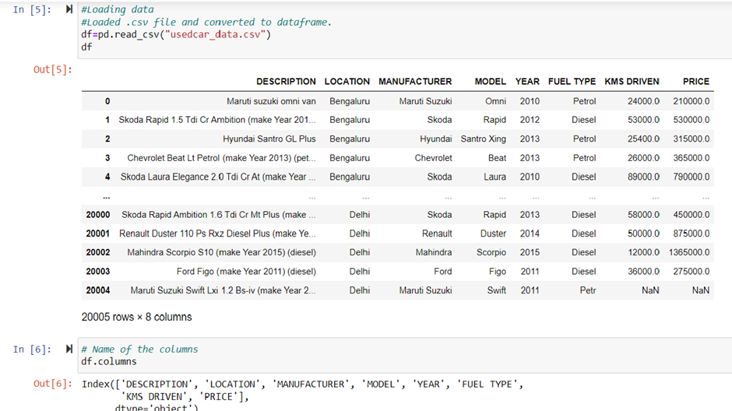
Data Cleaning
Here we can see that we have 20005 rows and 8 columns in our datasets.
Also we can see the columns name in our data set

Slide 9
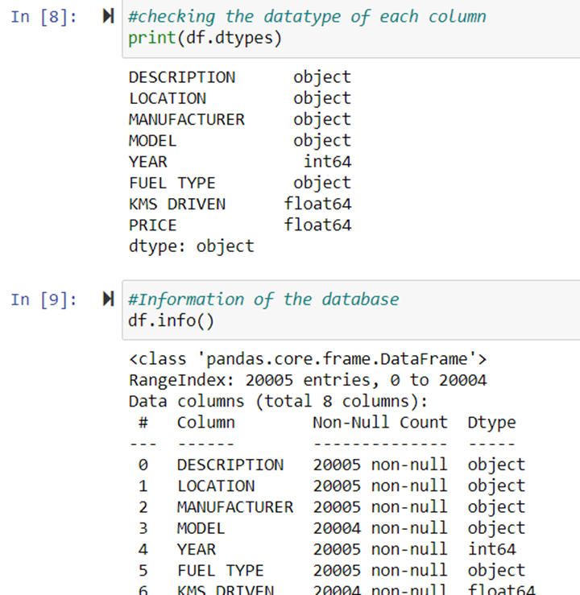

Slide 10
Data has been scrapped from cardekho website so we have to clean it for our convenience.
In my datasets I found null values, outliers and also skewness.
I have used imputation method to replace null values. To remove outliers I have used Z-score method. And to remove skewness I have used yeo-johnson method.
To encode the categorical columns I have use Label Encoding.
Use of Pearson’s correlation coefficient to check the correlation between dependent and independent features.
Also I have used standardization. Then followed by model building with all regression algorithms.

Slide 11
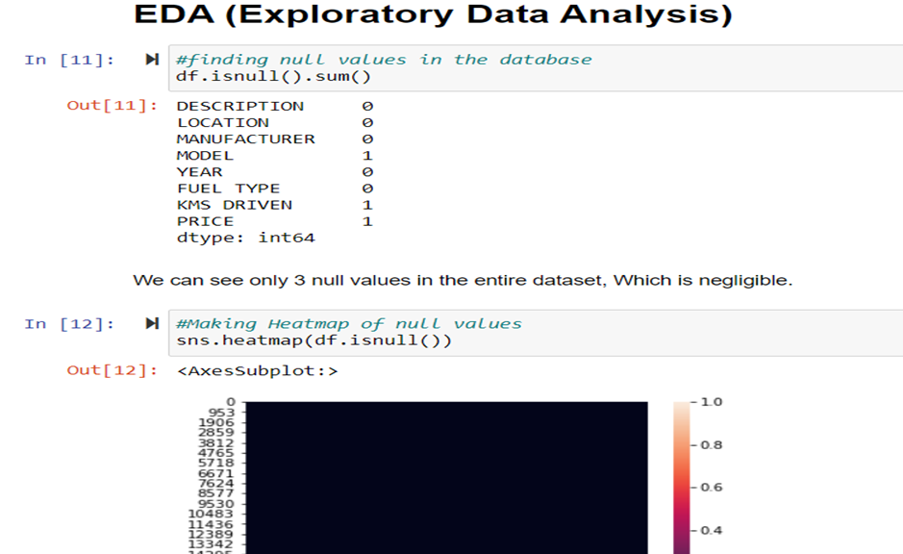
Exploratory Data Analysis

Slide 12
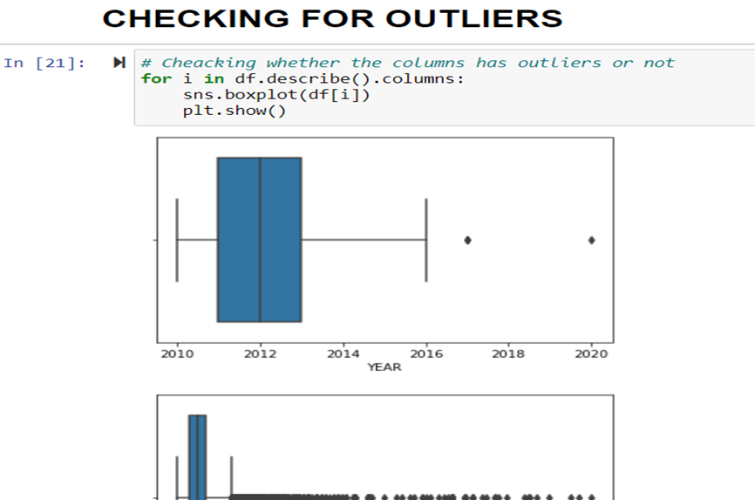
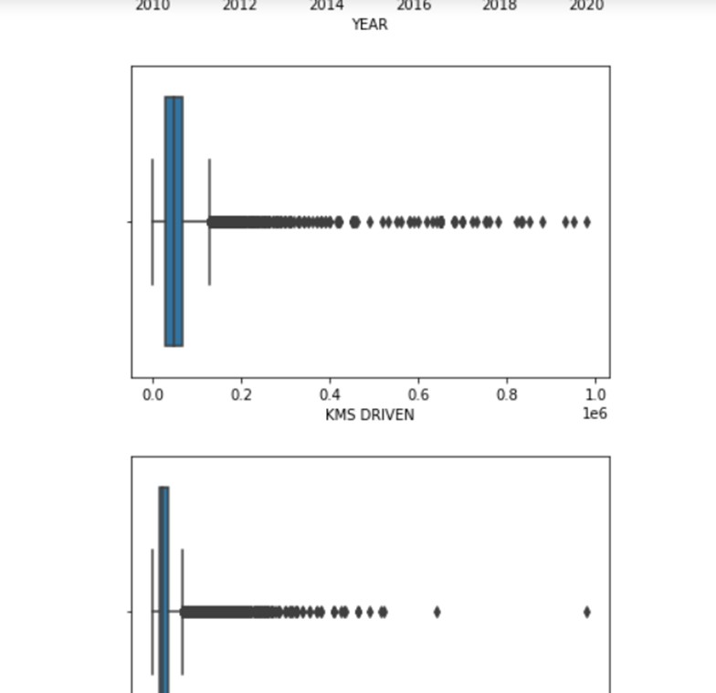
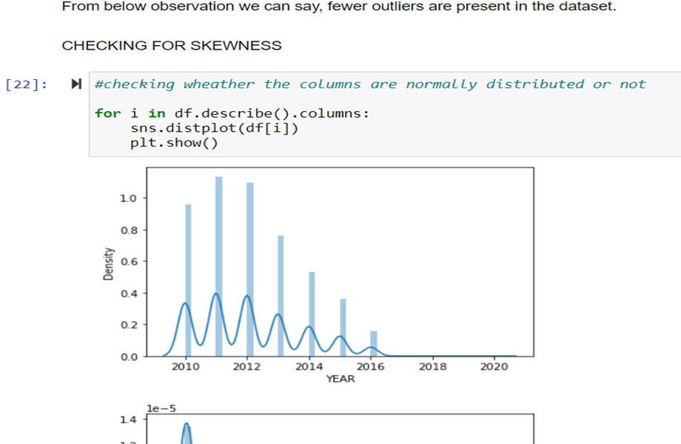
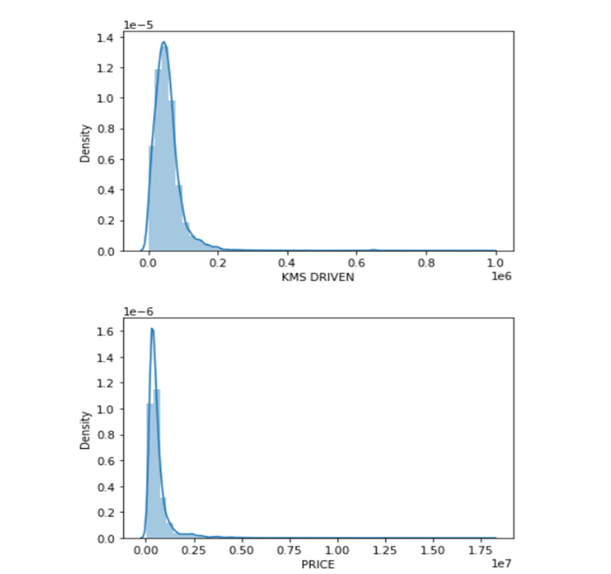

Slide 13
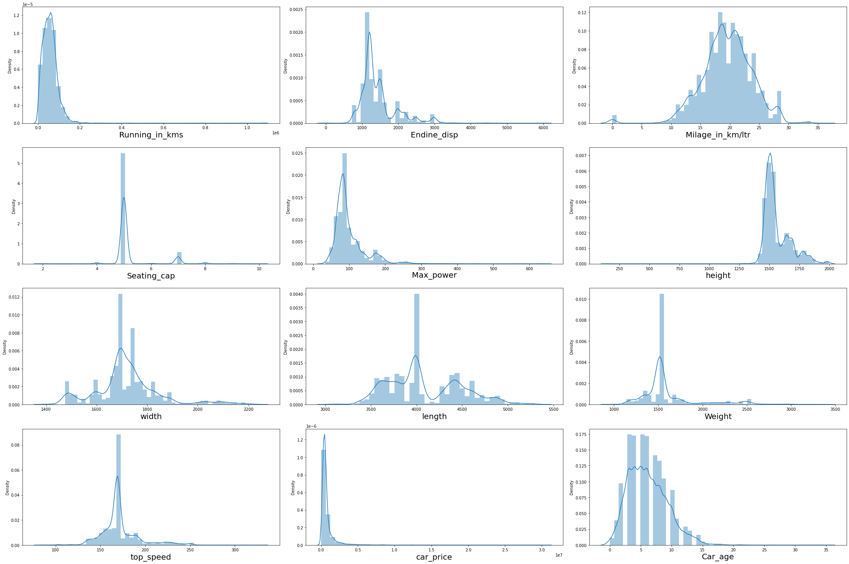

Slide 14
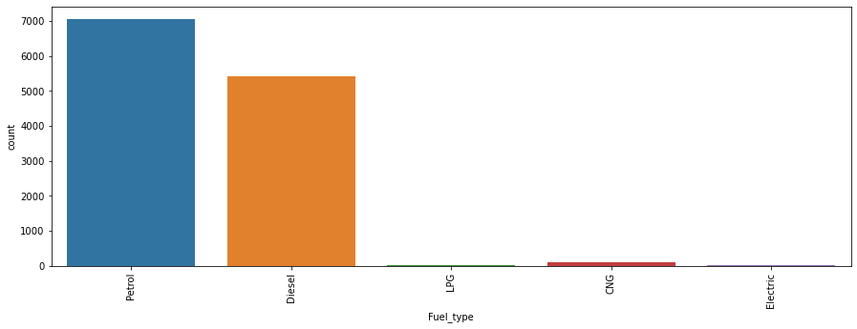
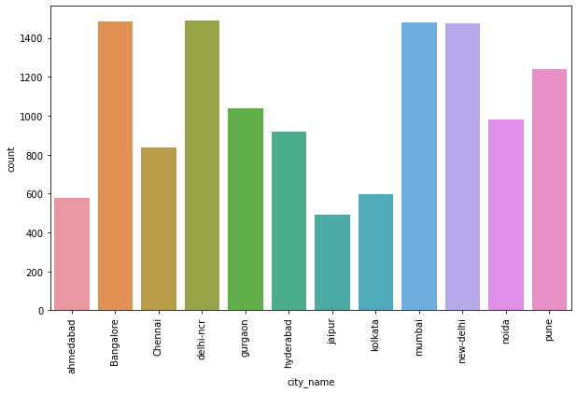
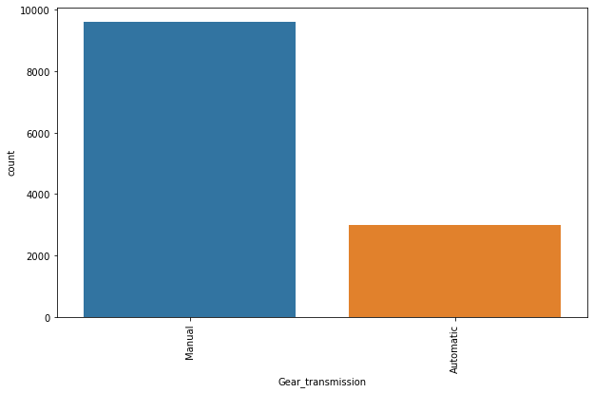
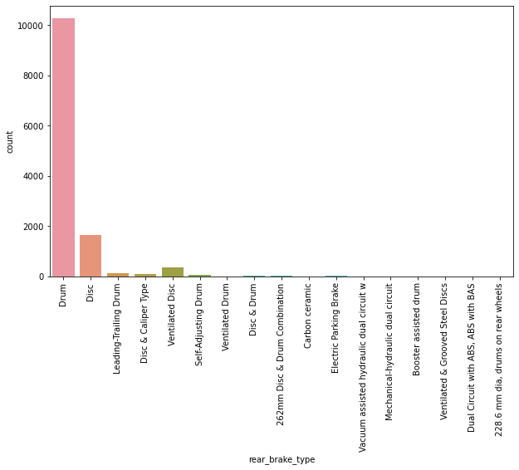
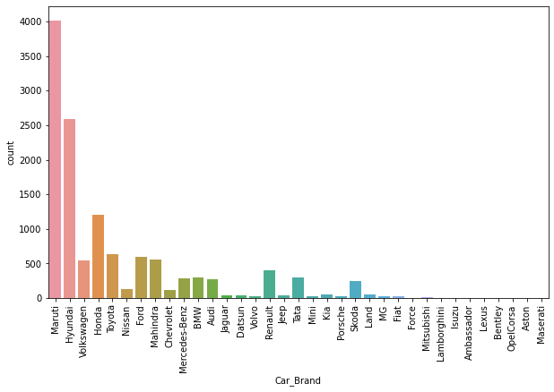
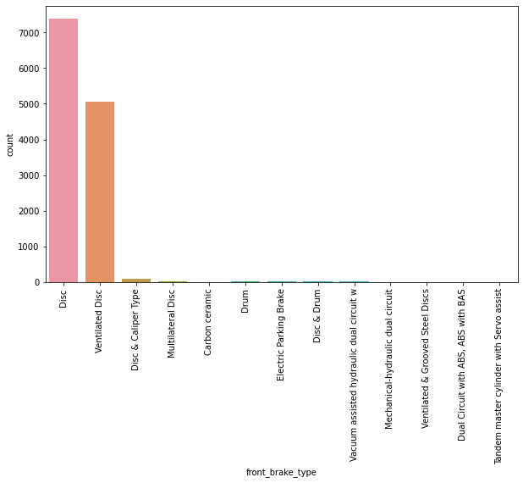
Univariate Vizualization of Categorical columns:

Slide 15
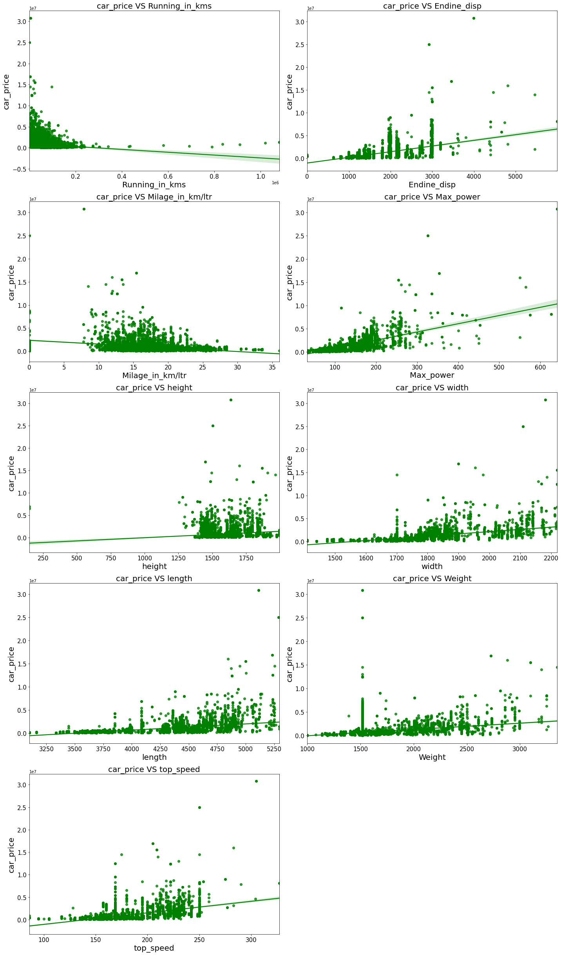
Bivariate Vizualization of numerical columns:

Slide 16
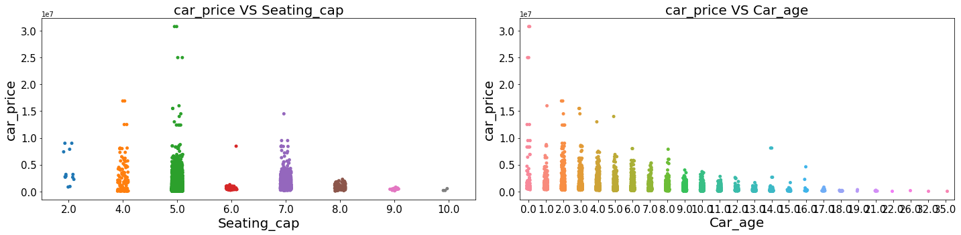
Bivariate Vizualization of numerical columns:

Slide 17
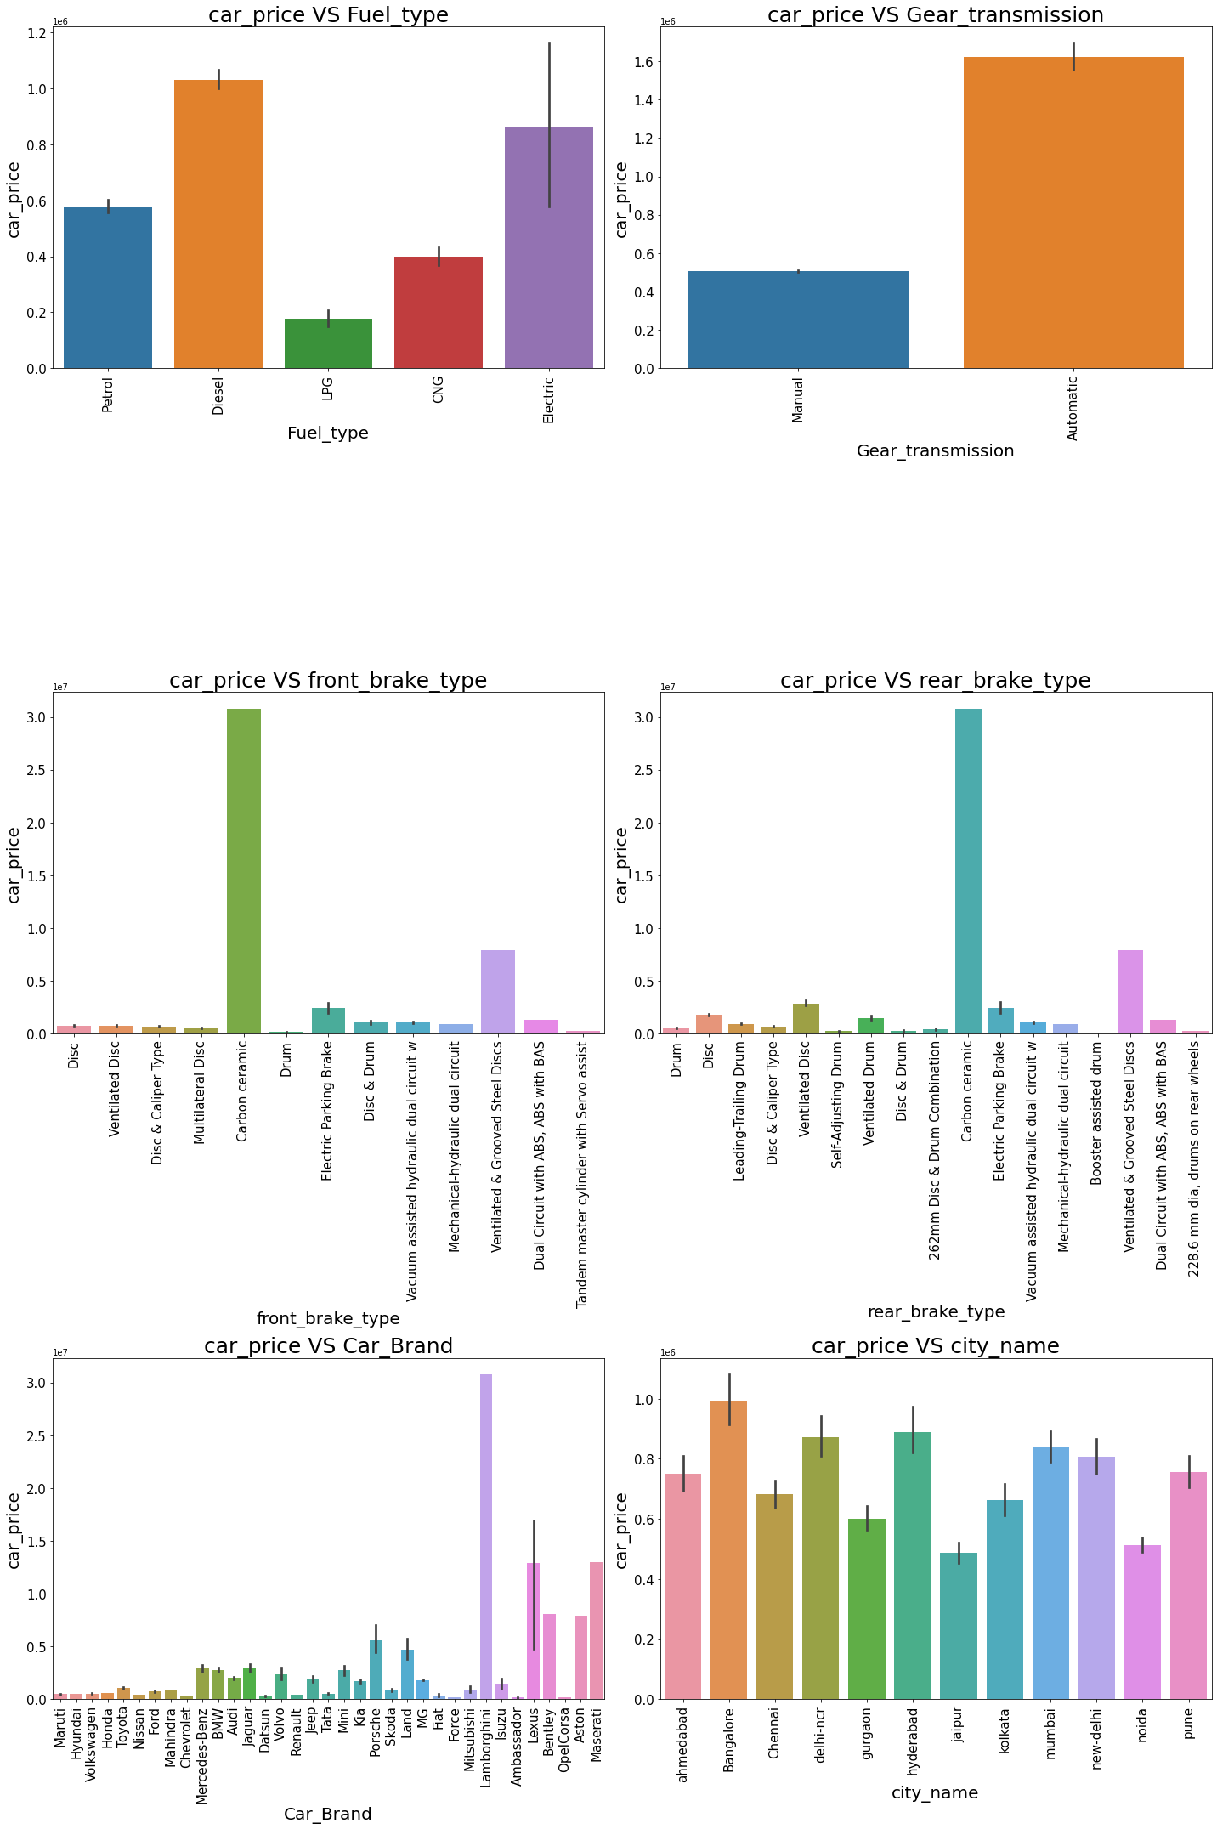
Bivariate Vizualization of categorical columns:

Slide 18
Observations:
For Diesel and Electric cars the price is high compared to Petrol, LPG and CNG.
Cars with automatic gear are costlier than manual gear cars.
Cars with Carbon Ceramic front break are costlier compared to other cars.
Cars with carbon Ceramic rear break are costlier compared to other cars.
Lamborghini brand cars are having highest sale price.
In Bangalore, Hyderabad and delhi-ncr the car prices are high as they are highly populated cities.

Slide 19
Model Building:
Since Car Price was my target and it was a continuous column so this perticular problem was regression problem. And I have used all regression algorithms to build my model. By looking into the difference of r2 score and cross validation score I found DecisionTreeRegressor as a best model with least difference. Also to get the best model we have to run through multiple models and to avoid the confusion of overfitting we have go through cross validation. Below are the list of regression algorithms I have used in my project.
RandomForestRegressor
XGBRegressor
GradientBoostingRegressor
DecisionTreeRegressor
BaggingRegressor

Slide 20
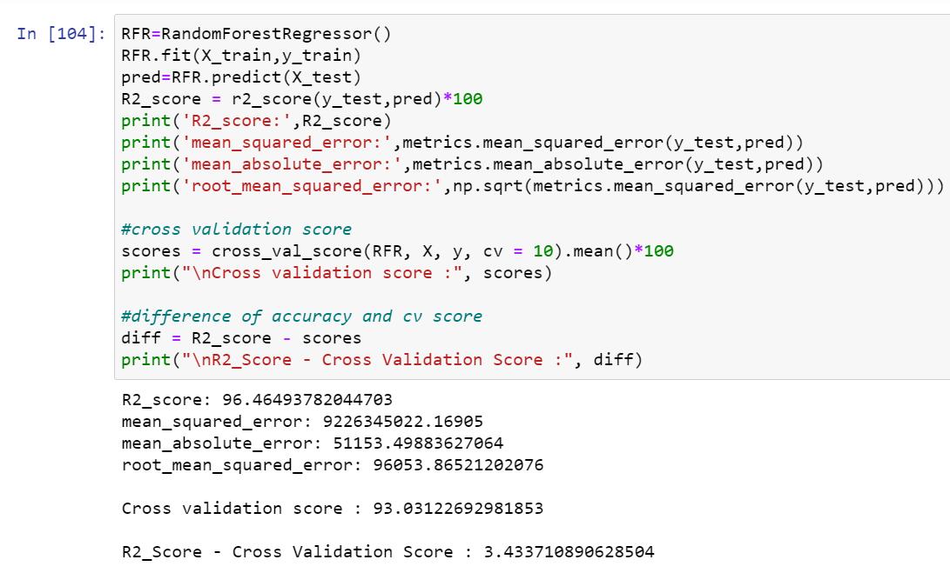
1) RandomForestRegressor:
RandomForestRegressor has given me 96.46% r2_score and the difference between r2_score and cross validation score is 3.43%, but still we have to look into multiple models.

Slide 21
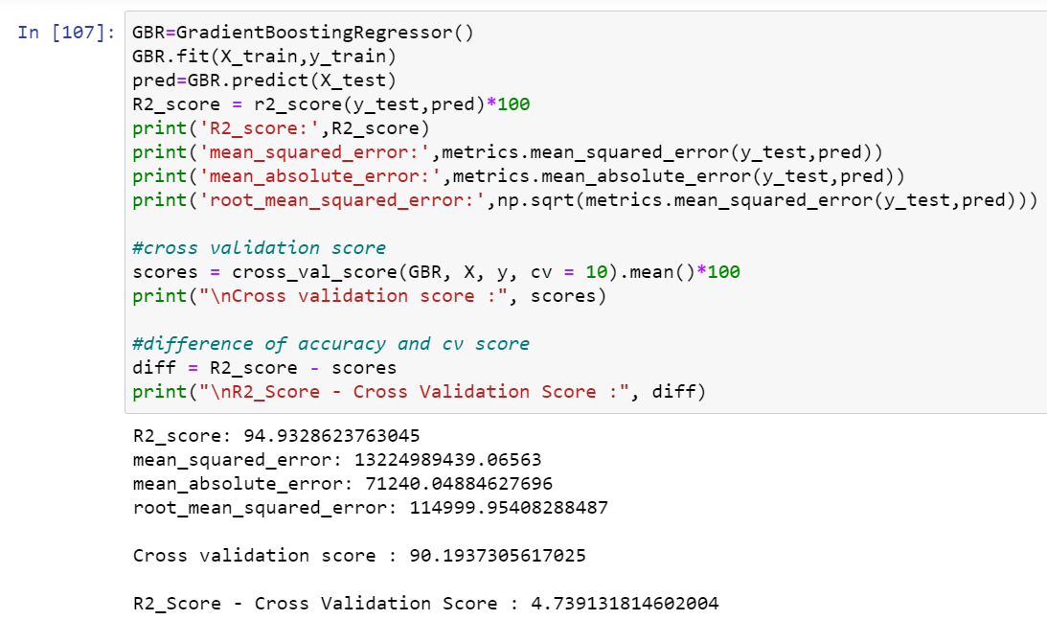
2) GradientBoostingRegressor:
GradientBoostingRegressor is giving me 90.193% r2_score and the difference between r2_score and cross validation score is 4.74%.

Slide 22
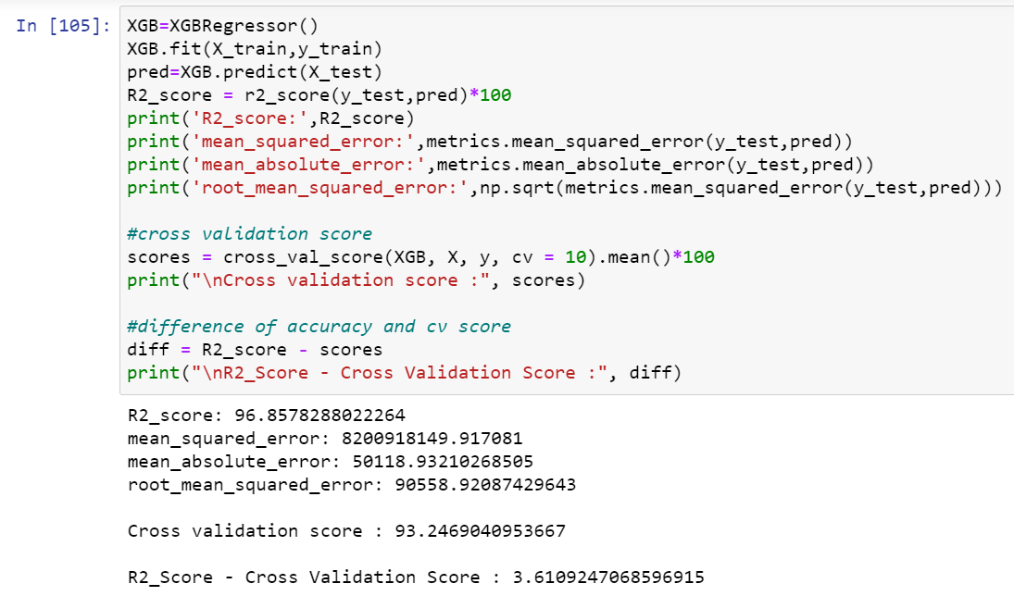
3)XGBRegressor
XGBRegressor is giving me 93.24% r2_score and the difference between r2_score and cross validation score is 3.61%.

Slide 23
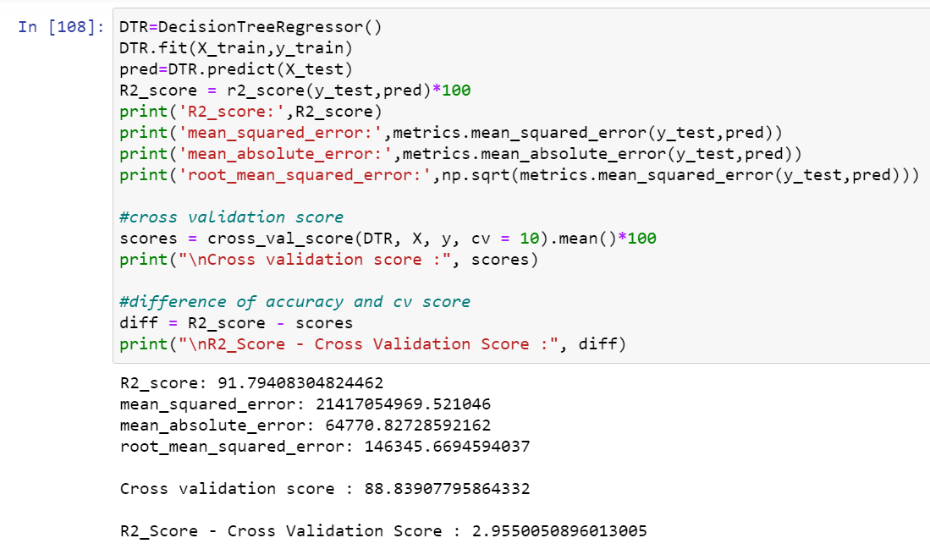
4) DecisionTreeRegressor:
DecisionTreeRegressor is giving me 88.83% r2_score and the difference between r2_score and cross validation score is 2.96%.

Slide 24
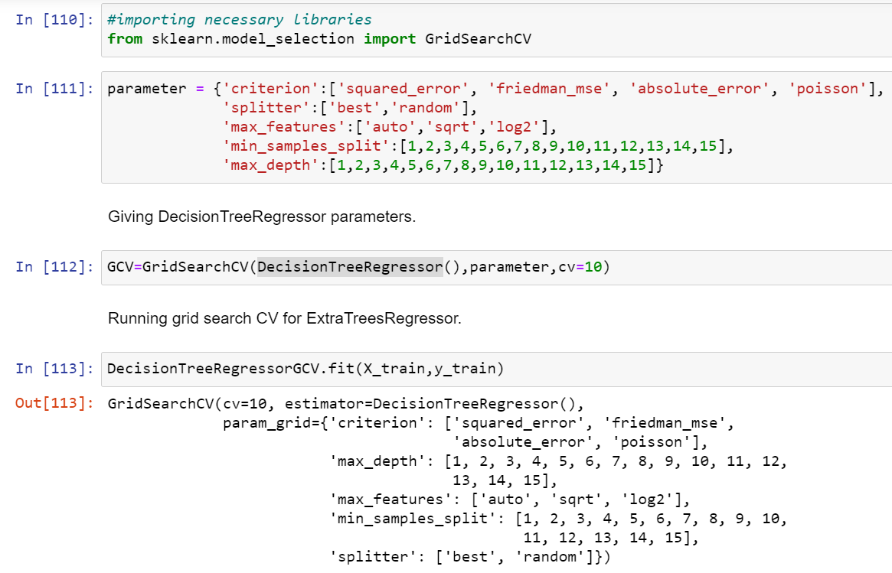
Hyper Parameter Tunning:

Slide 25
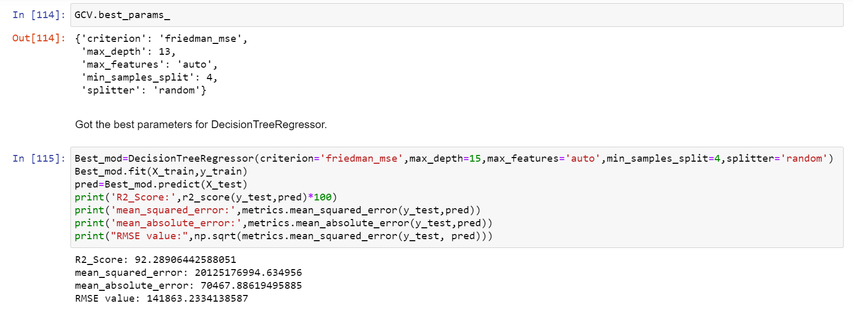
Hyper Parameter Tuning:
I have choosed all parameters of DecisionTreeRegressor, after tunning the model with best parameters I have incresed my model accuracy from 91.79% to 92.29%.

Slide 26
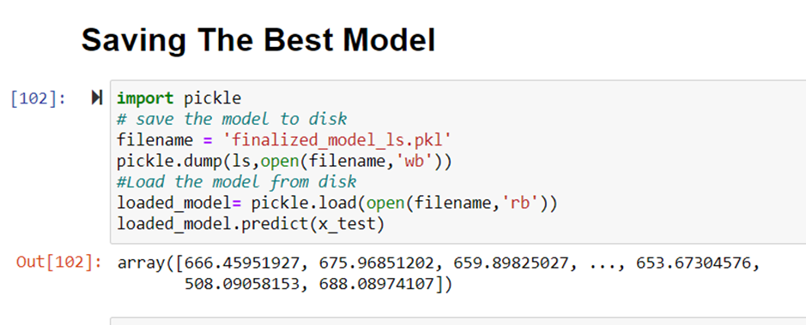
Saving the model and predictions using saved model:

Slide 27
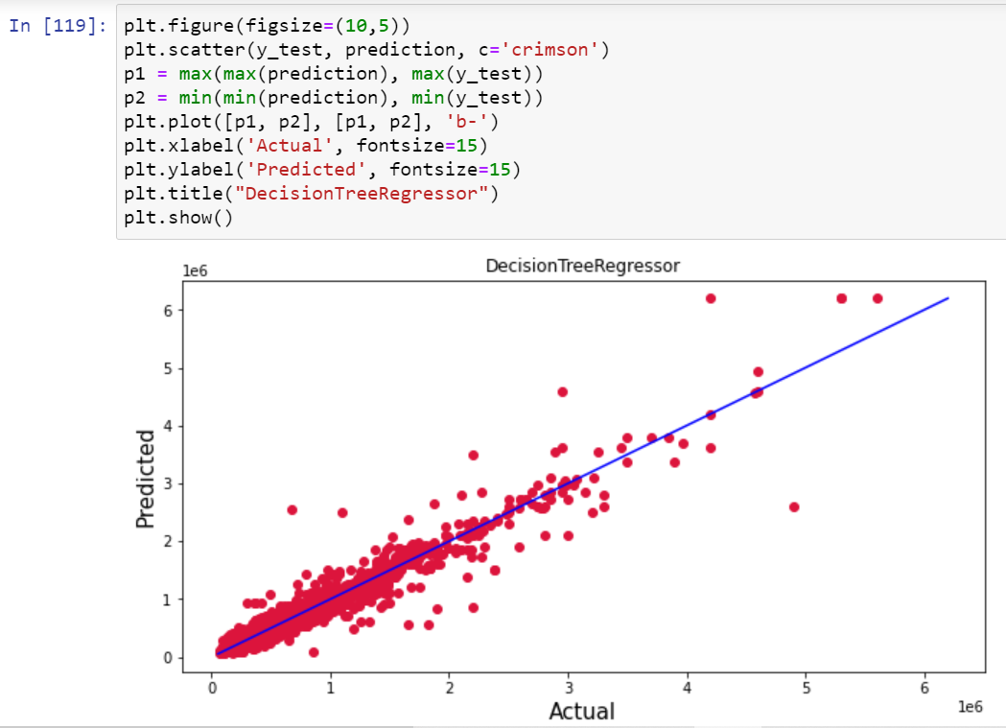
Plotting the predicted values v/s actual values:
Plotting Actual vs Predicted, To get better insight. Bule line is the actual line and red dots are the predicted values.

Slide 28
Conclusion:
In this Used car prediction Project, we have evaluated the factors influencing the selling price of used cars. We have evaluated the major features contributing the selling price of cars. Though this is the simplest model we have built till now, the final predictors still seem to have high correlations. Determining whether the listed price of a used car is a challenging task, due to the many factors that drive a used vehicle’s price on the market. The focus of this project is developing machine learning models that can accurately predict the price of a used car based on its features, in order to make informed purchases. We implement and evaluate various learning methods on a dataset consisting of the sale prices of different makes and model across cities.
Data cleaning is one of the most important steps to remove unrealistic values and unnecessary values.
These feature set were then given as an input to five algorithms and a hyper parameter tunning was done to the best model and the accuracy has been improved. Hence we calculated the performance of each model using different performance metrics and compared them based on these metrics.
Then we have also saved the best model and predicted the car price. It was good that the predicted and actual values were almost same.
To conclude, the application of machine learning in car price prediction is still at an early stage. We hope this study has moved a small step ahead in providing some methodological and empirical contributions to online platforms, and presenting an alternative approach to the valuation of used car price.
Future direction of research may consider incorporating additional used car data from a larger economical background with more features.

Slide 29
Thank you for watching

